Slide 1
Hematopoietic cancers and Nup98 fusions: determining common mechanisms of malignancy.
Ph.D. candidacy examination
Juliana Silva Capitanio
Department of Cell Biology
Faculty of Medicine and Dentistry
University of Alberta

Slide 2
Background:
NUP98 translocations in hematological malignancies.

Slide 3
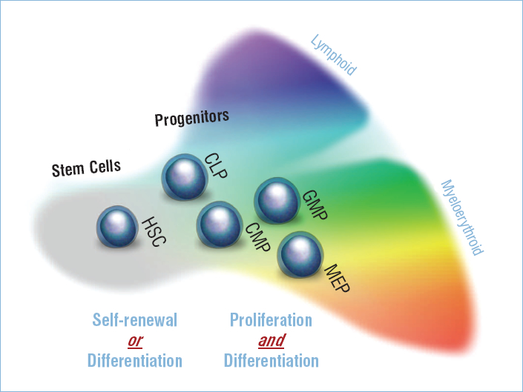
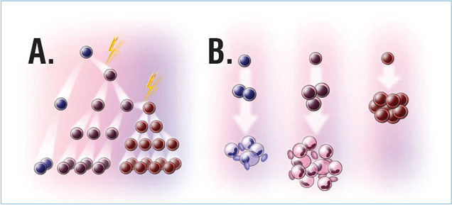
Leukemia is a severe hematological malignancy, it originates in hematopoietic stem cells that accumulate mutations.
Canadian cancer society 2011:
5000 new cases;
2500 deaths.
Most common cancer in youth (26%);
Malignancy with highest mortality;
AML: most severe (67% survival).
Lymphocytic
Myelogenous
Acute
ALL
AML
Chronic
CLL
CML
NIH stem cell information website

Slide 4
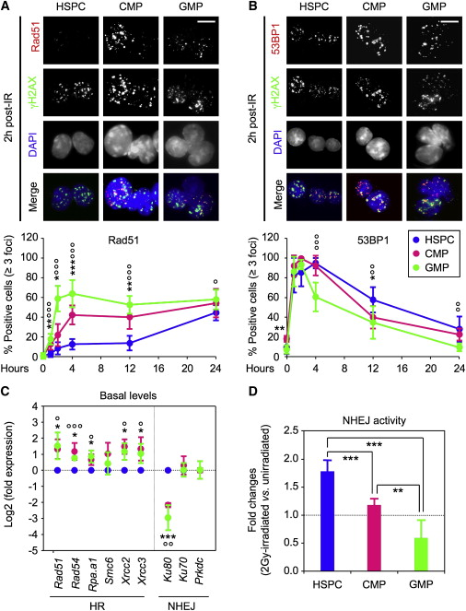
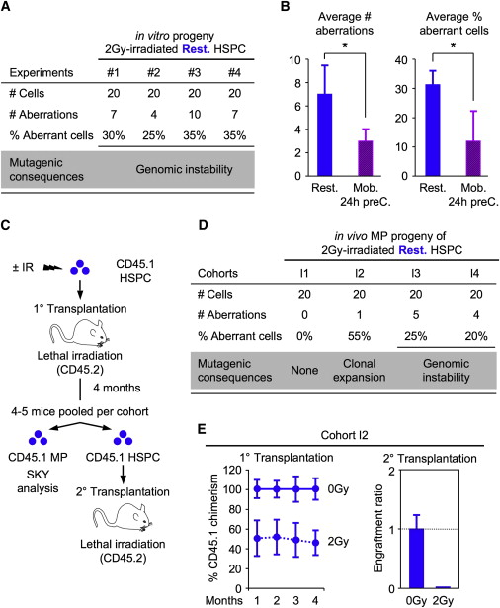
HSCs repair DNA double strand breaks through NHEJ, often causing chromosomal aberrations.
Mohrin, M et al, 2010, Cell Stem Cell

Slide 5
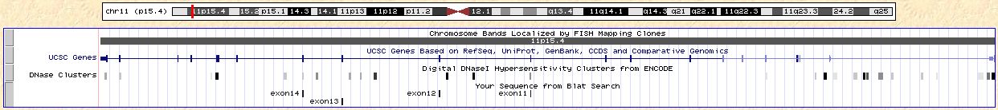
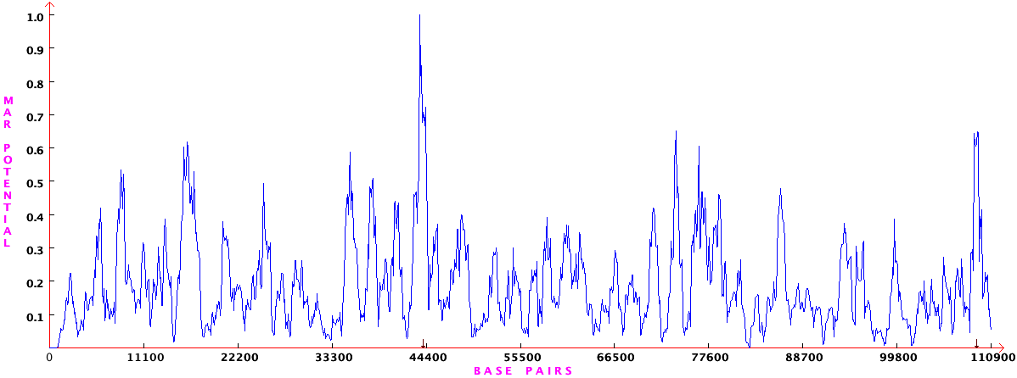
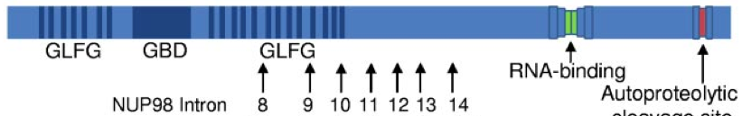
NUP98 translocations occur in regions sensitive to DSB, fusion proteins always maintain the N-terminal domain of Nup98.
Gough SM, Blood, 2011
Notes:
NUP98 translocations:
Rare (2% AML cases), poor prognosis
50% patients under 20 years, 25% therapy related malignancy
Simple karyotype

Slide 6
Some NUP98 translocations have similar effects in the cell.
NUP98 translocations expand the pool of self-renewing undifferentiated HSCs.
Nup98 fusions are dispersed through the nucleus.
Nup98 fusions affect the expression of a few groups of genes:
A) genes encoding HD proteins,
B) interferon-inducible genes,
C) genes involved in myeloid differentiation.
Fusion partners fall into 3 main groups:
A) directly bind DNA and alter gene transcription (HD transcription factors),
B) facilitate protein interaction with transcriptional co-factors (coiled-coil domains),
C) “writing” or “reading” chromatin marks to alter gene transcription (PHD, SET domain).
* Results available for a limited number of NUP98 fusions.

Slide 7
Common characteristics of Nup98 fusions: recurring domains, DNA / chromatin interaction and transcriptional deregulation.
Gough SM, Blood, 2011

Slide 8
Hypothesis formulation:
Nup98 fusions as rogue transcriptional regulators.

Slide 9
Hypothesis formulation:
BACKGROUND: Very few well characterized fusions.
Similar to other leukemic fusions:
nuclear, DNA-binding, affecting epigenetics and transcription.
Similar genes with altered expression:
Genes encoding HD proteins, IFN response proteins, myeloid differentiation players.
Type II mutations:
Decreased differentiation, increased self-renewal.
PARTNER GENES ANALYSIS: Similar characteristics may indicate similar mechanisms.
DNA/Chromatin interaction – especially AML translocations.
All fusions contain: homeodomain, PHD finger or coiled-coil domain.
Biological processes enrichment: transcriptional regulation, differentiation, proliferation.
Nup98 fusions might function as rogue transcriptional regulators impairing differentiation and increasing self-renewal in leukemic cells.

Slide 10
Preliminary results:
Nup98 fusions effects in gene expression

Slide 11
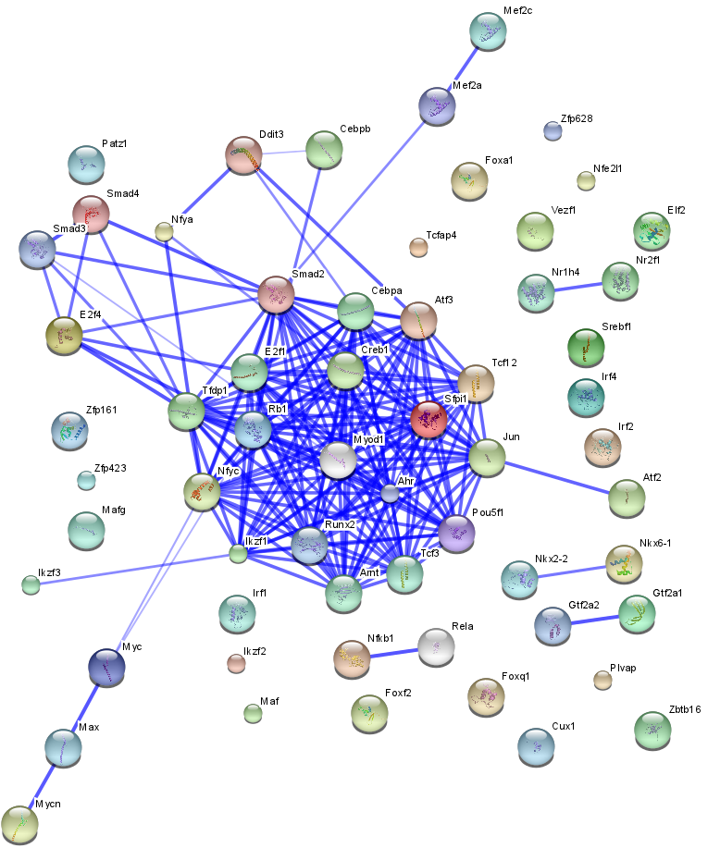
Different Nup98 fusions can affect the expression of similar genes, regulated by a group of transcription factors in common.

Slide 12
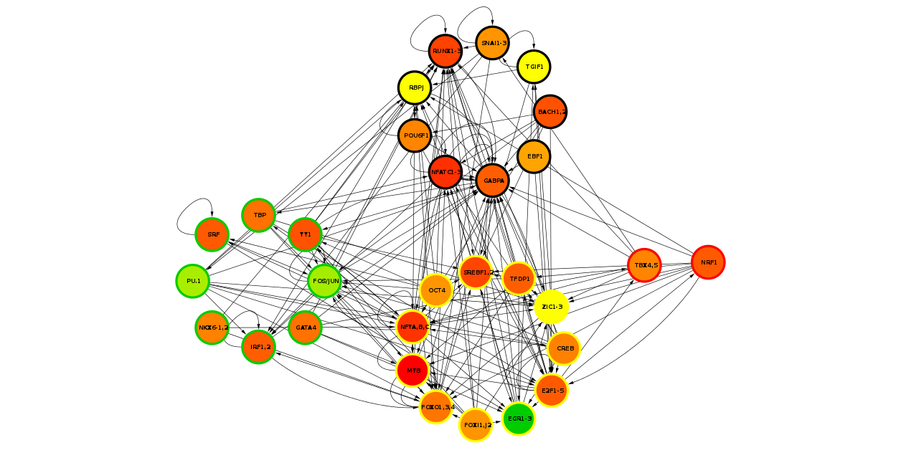
The transcription factors regulating genes with altered expression are highly interconnected and overlap with the network regulating growth arrest and differentiation in myeloid cells.

Slide 13
Aims overview:
Network level understanding of Nup98 fusions in leukemic cells.

Slide 14
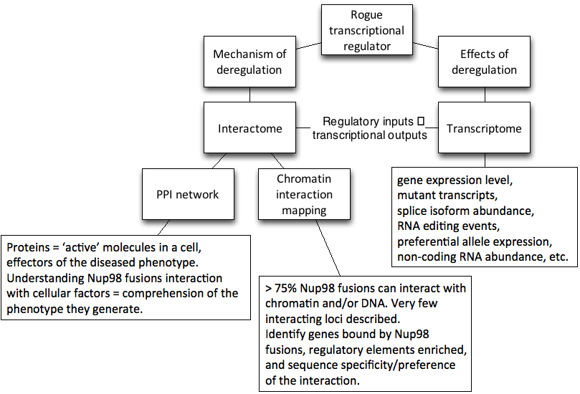
HYPOTHESIS: Nup98 fusions might function as rogue transcriptional regulators impairing differentiation and increasing self-renewal in leukemic cells.
AIM: Network level understanding of the role NUP98 translocations play in leukemogenesis.
AIM 1
AIM 2

Slide 15
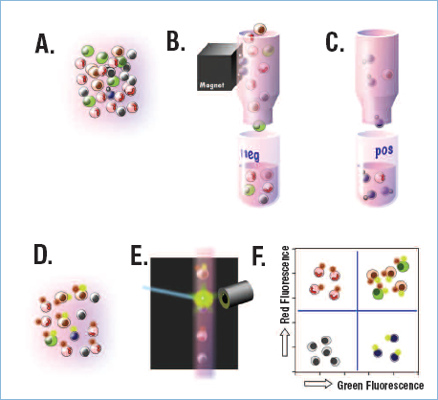
Experimental model: human hematopoietic stem cells
Sources:
Umbilical cord blood cells
Bone marrow
Inside bone
Mobilized to blood
Surface markers:
CD133+
CD34+
CD59+
CD90+
CD38-
CD117+
LIN-
NIH stem cell information website

Slide 16
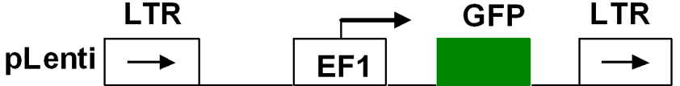
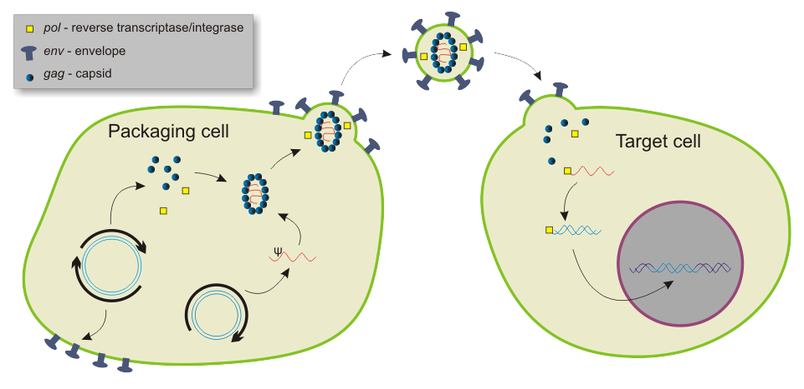
Experimental model: lentiviral transduction of constructs
Approximately 50X overexpression in HSCs.
Wikipedia

Slide 17
AIM 1: Constructing the interactome of Nup98 fusion oncoproteins - Determining protein interaction networks for Nup98 fusions
Previously known interactions:
CBP/p300,
HDAC1,
AES.
Partner genes analysis:
Over 60% contain coiled-coil domain (protein interaction)
Preliminary results:
- Highly interconnected network of TFs regulating genes with altered expression in NUP98 translocations, possible protein interactions ex: WT1 and Nup98 fusions interact with CBP.
Notes:
Importance for project:
Very few interactions known, too much supposition in the literature.
Transcriptional regulators are commonly part of protein complexes.
Protein interactions can indicate function, localization, cellular pathways, etc..

Slide 18
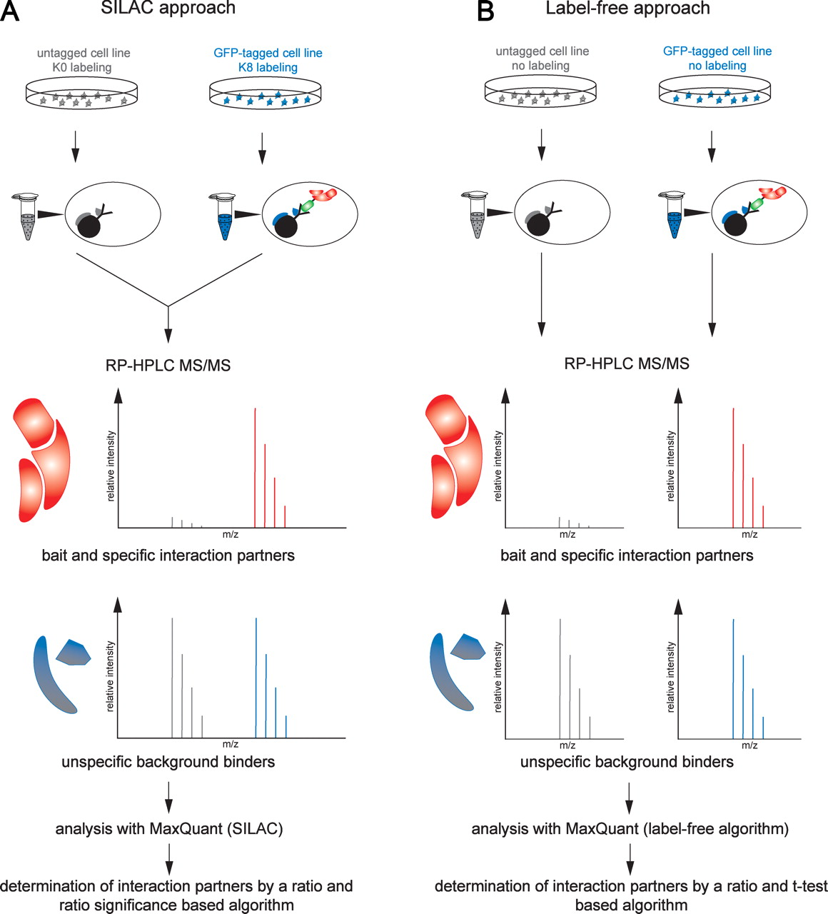
AIM 1: Constructing the interactome of Nup98 fusion oncoproteins - Determining protein interaction networks for Nup98 fusions Affinity purification and protein identification (mass spectrometry)
1
2
3
Hubner NC et al, J Cell Biol. 2010

Slide 19
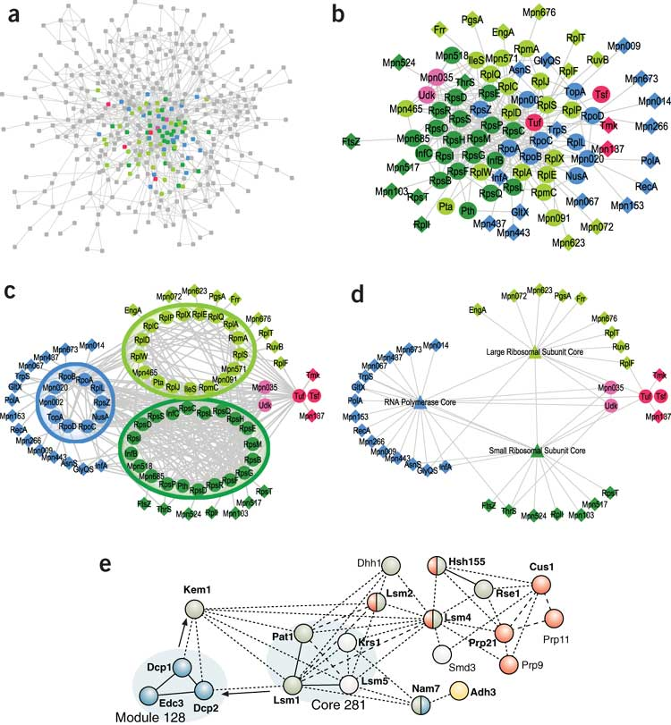
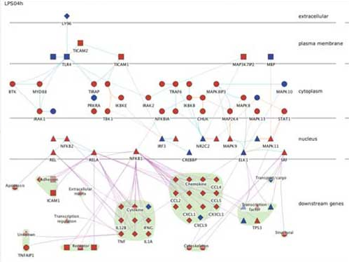
Result analysis: Network theory
Compare protein list to protein interaction databases.
Design protein interaction networks.
Identify network hubs and clusters (protein complexes).
Map cellular localization, biological processes and pathways in the network.
Compare groups of networks and extract: differential disease networks (perturbed and novel interactions), common processes affected in groups of networks, etc..
Gehlenborg N et al, Nat Methods, 2010

Slide 20
AIM 1: Constructing the interactome of Nup98 fusion oncoproteins - Mapping genome-wide Nup98 fusion interaction with chromatin
Previously known interactions:
NUP98-HOXA9: KBTBD10
NUP98-KDM5A: HOXA6 to HOXA10 (H3K4me3, acetylated histones)
NUP98-NSD1: HOXA7 and HOXA9 (H3K36me3, acetylated histones)
Partner gene analysis:
Over 75% of partner genes can interact with DNA / chromatin.
Several involved in transcription and chromatin modification.
Preliminary results:
- Genes with altered expression have several regulatory elements in common, they might target the interaction of Nup98 fusions.

Slide 21
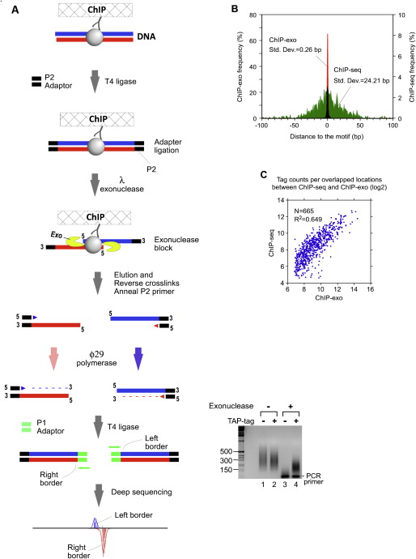
AIM 1: Constructing the interactome of Nup98 fusion oncoproteins - Mapping genome-wide Nup98 fusion interaction with chromatin
Chromatin immunoprecipitation and deep sequencing
Rhee HS, Pugh BF Cell, 2011

Slide 22
Result analysis:
Park PJ, Nat. Rev. Genet. 2009
Integrate results with protein interaction network, perform similar analysis.

Slide 23
AIM 2: Effects of NUP98 translocations in the transcriptome of HSCs
Previously published microarray results:
Common themes: groups of differentially expressed genes.
Several fusions not evaluated.
Few comparisons of different fusions.
Partner gene analysis:
Several fusion partners known to affect transcription or chromatin modifications, can lead to altered gene expression, splicing, post-transcriptional silencing, etc..
Preliminary results:
- Indicate similar groups of genes affected and possible regulatory networks altered.
Notes:
Importance for project:
Identifying the effects of these rogue transcriptional regulators (Nup98 fusions) in cellular processes.
Mapping the gene regulatory network affected.
Uncovering possible common drug targets.

Slide 24
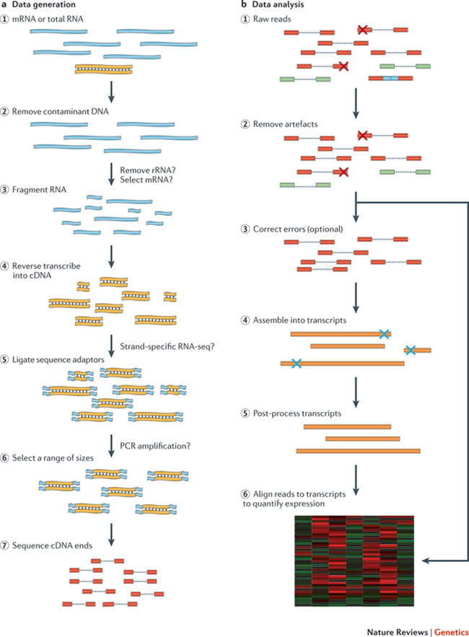
AIM 2: Effects of NUP98 translocations in the transcriptome of HSCs RNA purification and deep sequencing.
Martin JA, Wang Z. Nat Rev Genet 2011

Slide 25
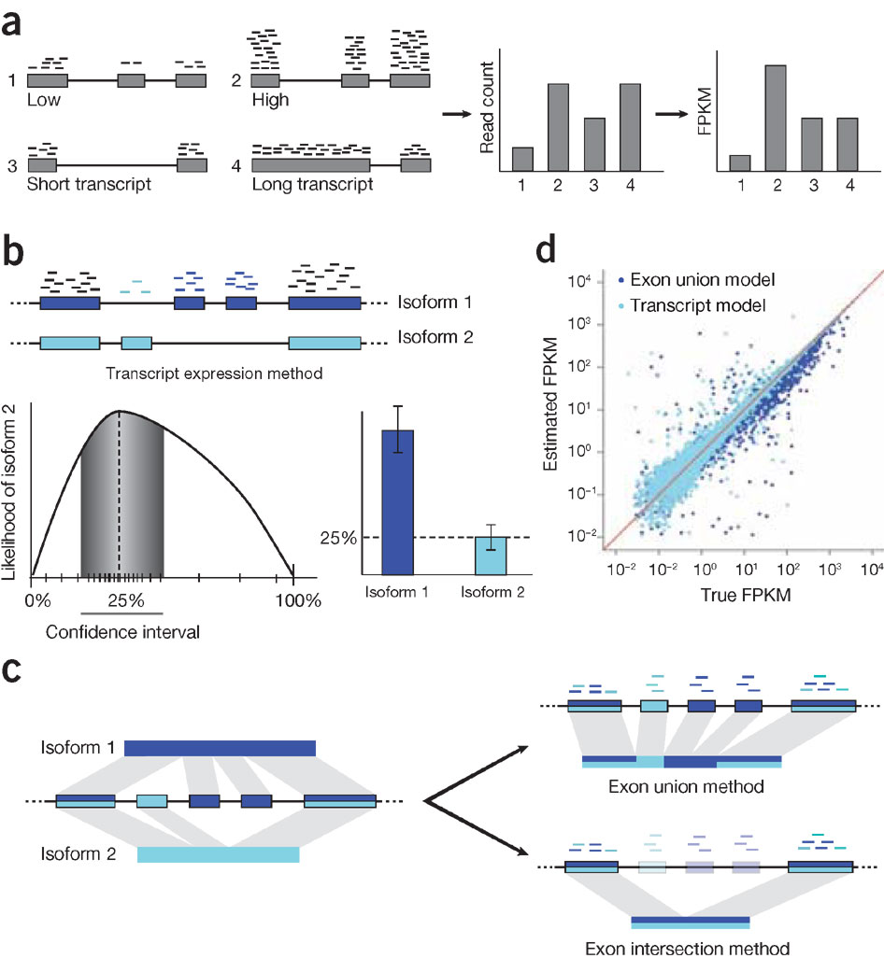
Gene expression level and isoform abundance analysis examples:
Garder M et al, Nat. Methods 2011
Transcriptome results can be added to the genomic maps from AIM 1.2 and to the PPI network from AIM 1.1.
New pattern search analysis, biological process enrichment, altered pathways mapping reveal causes of disease phenotype.
Notes:
(fragments per kilobase of exon per million fragments mapped)

Slide 26
Integrating results:
Merging results from AIM 1, AIM 2 and published data.

Slide 27
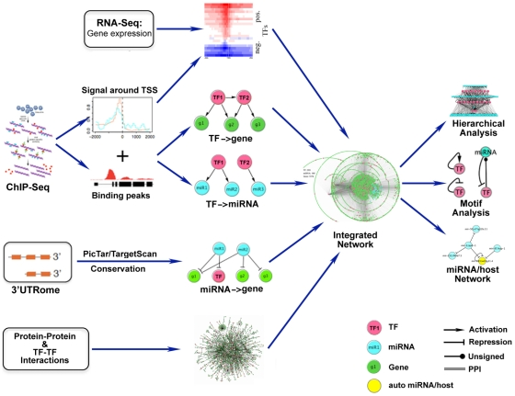
Mapping a regulatory network of gene expression.
Cheng C et al, PLoS Comp. Biol. 2011

Slide 28
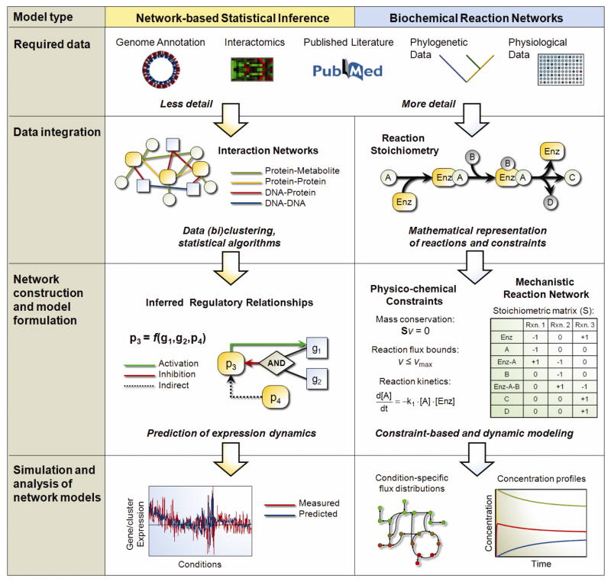
Edelman LB et al, Wiley Interdiscip Rev Syst Biol Med, 2011

Slide 29
Pathway integration of disease networks:
TCGA research group, Nature, 2011

Slide 30
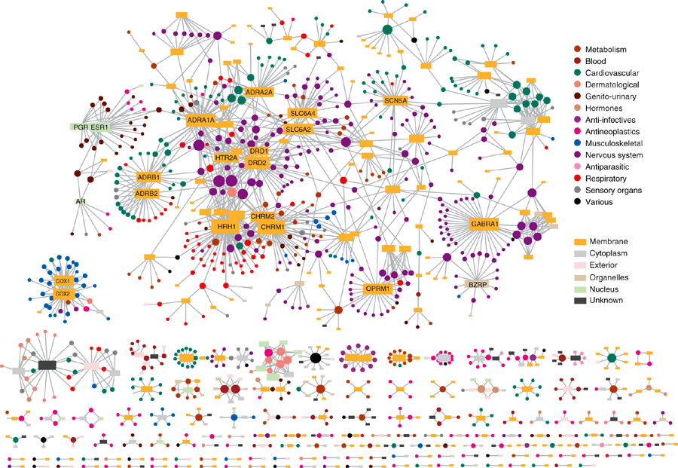
Linking to drug target networks:
Muhammed AY, Nat Biotech, 2007

Slide 31
Future perspectives:
Important goal of high-throughput integrative approach: generation of novel, testable hypotheses from data interpretation.
Identify groups of fusions with similar mechanisms:
Identify similar drug targets or prognostic / diagnostic markers;
Test transgenic mice or time-course of leukemogenesis for validation of models.
Determine common main affected pathways:
Multi-drug targeted therapy.
Targeted knock-down to refine pathway wiring.
Disease specific network:
Disease modeling: pre-leukemic, chronic, acute leukemia;
Drug response modeling.

Slide 32
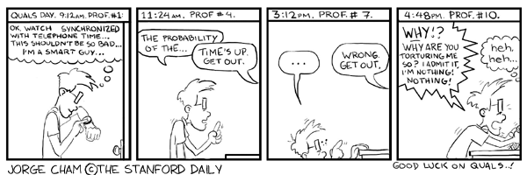
Thank you!

Slide 33
AIM 1: Constructing the interactome of Nup98 fusion oncoproteins - Determining protein interaction networks for Nup98 fusions
Caveats of this method:
Identifying appropriate tag / antibody for purification.
Optimizing affinity purification conditions: preserve weak interactions vs. reduce sample complexity.
Separating specific from background interactions.
High mass, high abundance proteins might mask low mass, low abundance ones.
Alternatives:
Tandem affinity purification,
Cross-linking of samples and stringent purification conditions,
Isotope-based quantification of proteins,
Resolve sample by gel electrophoresis (2D-PAGE, SDS-PAGE).

Slide 34
AIM 1: Constructing the interactome of Nup98 fusion oncoproteins - Mapping genome-wide Nup98 fusion interaction with chromatin
Caveats of this method:
Requires optimum antibody.
Cross-linking agent and time optimization required.
Background interactions.
Deep sequencing caveats: coverage, short-reads, base composition, alignment.
Alternatives:
ChIP-exo decreases background.
Use of ideal sequencing conditions and multi-step controls.
Correct for biases in data analysis step.
DamID (DNA adenine methyltransferase identification).

Slide 35
AIM 2: Effects of NUP98 translocations in the transcriptome of HSCs
Caveats of this method:
Bias in RNA purification and library preparation.
Sequencing bias (GC rich sequences), base change by random primers.
Appropriate depth of sequencing for quantification.
Proper transcript alignment (pseudogenes, repetitive sequences).
Alternatives:
Minimize DNA fragment amplification prior to library construction.
Use of ideal sequencing conditions and multi-step controls.
Verify sequence coverage before analysis.
Correct for biases in data analysis step.
Expected results and analysis

Slide 36
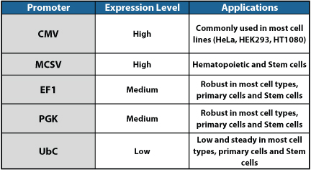
Lentivirus promoters
2011 System Biosciences, Inc

Slide 37
Affinity purification mass spec
PBS : Salt prevents non-specific protein aggregation
Tris-HCl, NaCl : Buffering agent prevents protein denaturation
1% NP-40, Igepal CA-630, Triton X-100: Non-ionic detergent to extract proteins, form lipid micelles
0.5% sodium deoxycholate, 0.1% SDS: Ionic detergent to extract membrane protein and isolate lipids
PMSF, EGTA, cocktail: Protease Inhibitor, Prevents protein degradation.
Na3VO4 (Sodium Orthovanadate) : Tyrosine phosphatase Inhibitor; hydrostatic interference of active sites of phosphatases
NaF (Sodium Fluoride) : Serine/Threonine phosphatase Inhibitor; hydrostatic interference of active sites of phosphatases
EDTA: DNAse inhibitor, prevents phosphorylation in the lysate.

Slide 38
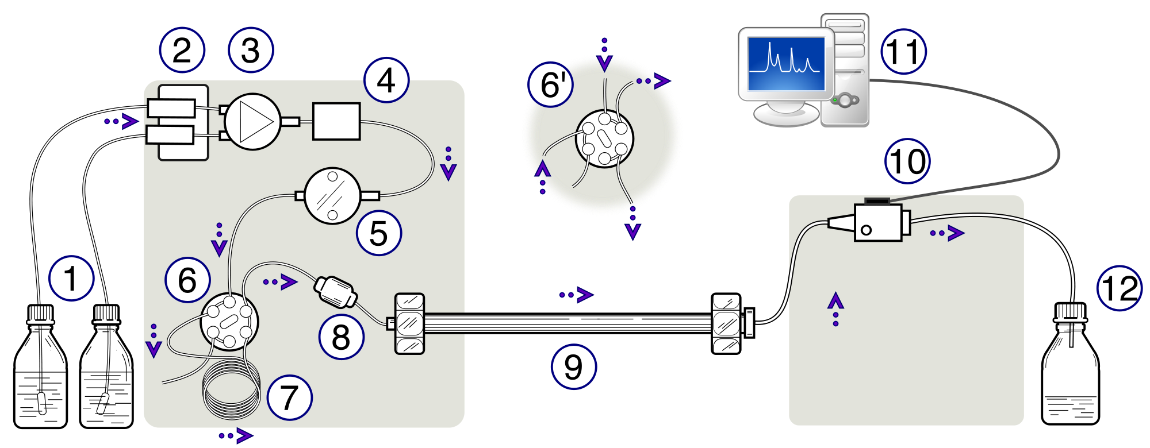
RP HPLC
Solvent
degasser
Gradient
valve
Mixing
vessel
Data acquisition
Detector
Solvent reservoirs
Switching valve
High-pressure pump
Pre-column
Analytical column
Waste or
fraction collector
Injection
loop
Wikipedia
Columns: silica particles, particle (5uM) and pore size (300A).
Stationary phase: hydrophobic alkyl chains, C4 (proteins), C18 (peptides).
Solvents: A - aqueous (water), B – organic (acetonitrile).

Slide 39
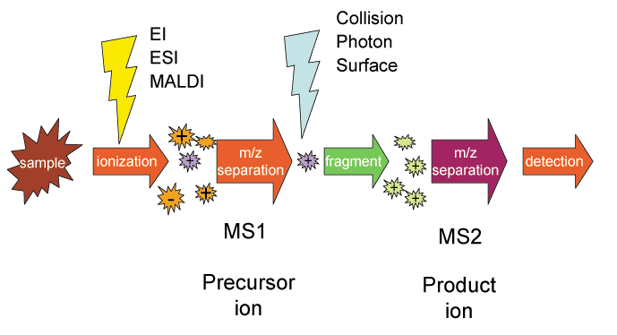
MS/MS
Wikipedia
High res: Ion Cyclotron (FT-ICR-MS); Time of Flight (TOF); Magnetic Sector.
Low res: Quadrupole Ion Trap; Quadrupole

Slide 40
NGS – two main plataforms
Metzker ML, Nat Rev Genet, 2010

Slide 41
Metzker ML, Nat Rev Genet, 2010

Slide 42
ChIP-seq
Park PJ, Nat. Rev. Genet. 2009

Slide 43
ChIP-seq alignment
Park PJ, Nat. Rev. Genet. 2009

Slide 44
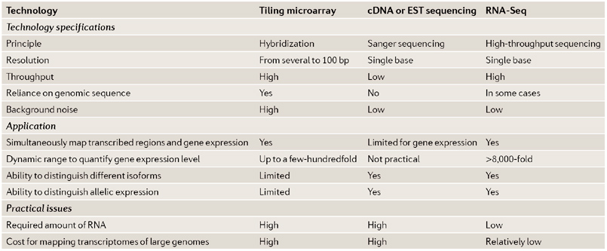
RNA-seq
Wang Z et al, Nat Rev Genet, 2009

